Slide 1
Computer Vision and Image Processing
Tirgul 14
Homography estimation, RANSAC
& Moriya Bitton

Slide 2
Homography Estimation

Slide 3
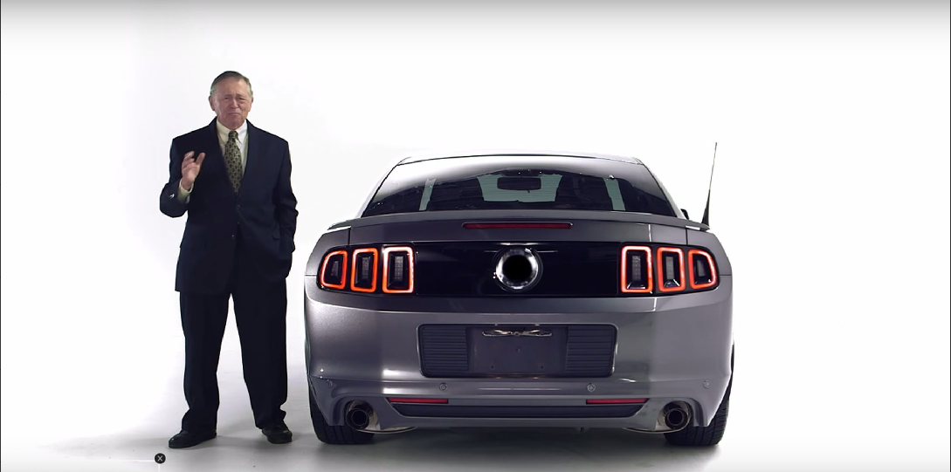

Recall Warping
H?

Slide 4
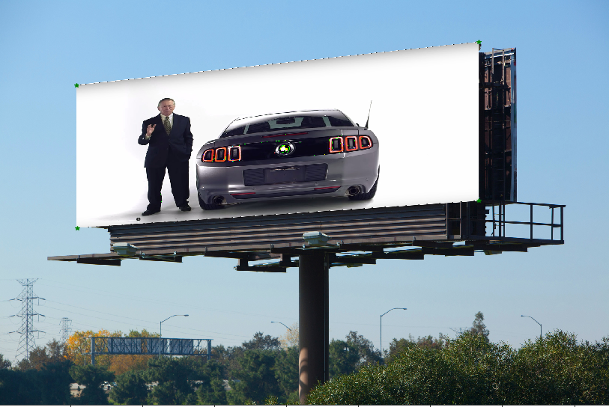
Recall Warping
H?
We know where we want to put the image, but how do we find the homography matrix?

Slide 5
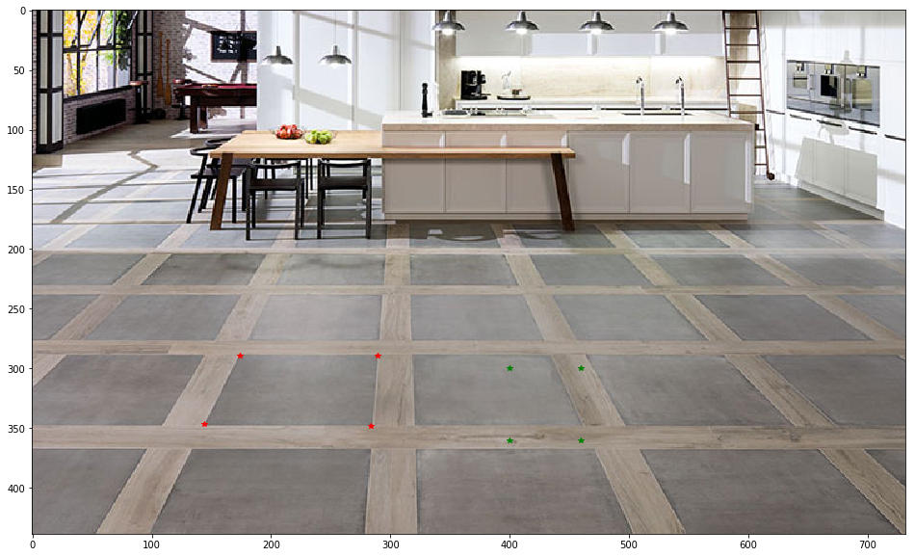
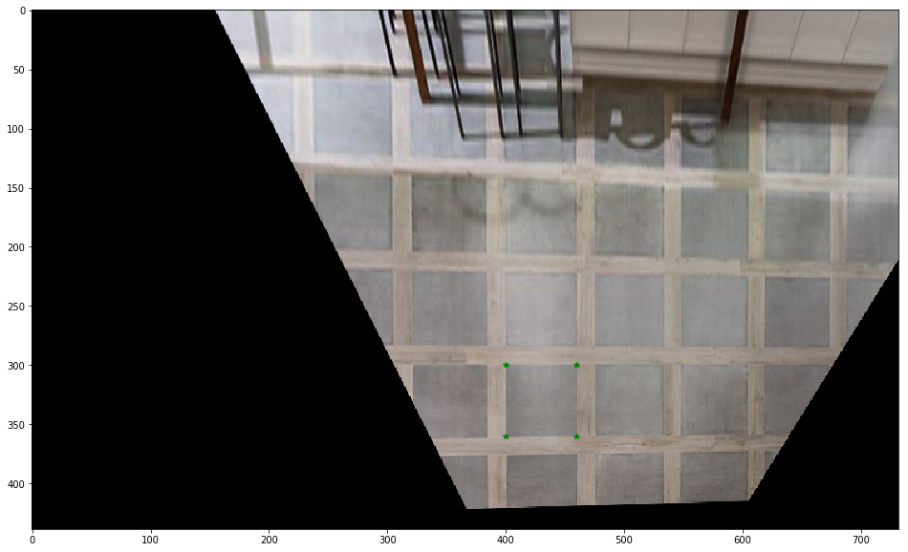
Recall Warping

Slide 6
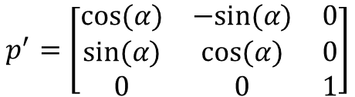
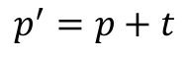
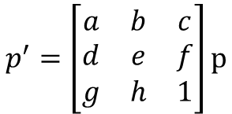
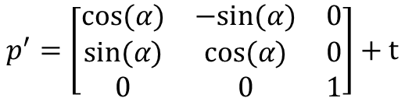
2D Transformation - Recap
Translation: 2 DOF
Rotation: 1 DOF
Similarity: 4 DOF
Perspective: 8 DOF
$$p^{′}=p+t$$
$$p^{′}=\left[\begin{matrix}cos⁡(α) & −sin⁡(α) & 0 \\ sin⁡(α) & cos⁡(α) & 0 \\ 0 & 0 & 1\end{matrix}\right]$$
$$p^{′}=\left[\begin{matrix}cos⁡(α) & −sin⁡(α) & 0 \\ sin⁡(α) & cos⁡(α) & 0 \\ 0 & 0 & 1\end{matrix}\right]+t$$
$$p^{′}=\left[\begin{matrix}a & b & c \\ d & e & f \\ g & h & 1\end{matrix}\right]p$$

Slide 7
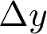

Translation

Slide 8
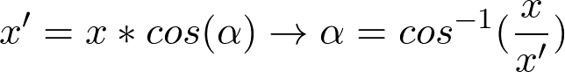
Rotation

Slide 9
Similarity
?

Slide 10
Similarity
?

Slide 11
Similarity
Needs 3 matches = 6 variables
This starts to be complicated, not to mention homography with 4 points (8DOF).

Slide 12
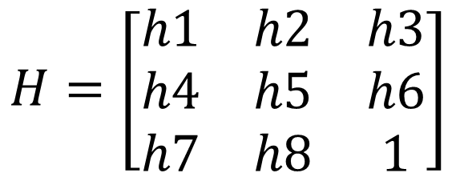
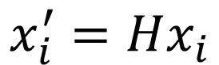
DLT- Direct Linear Transformation
$$H=\left[\begin{matrix}h1 & h2 & h3 \\ h4 & h5 & h6 \\ h7 & h8 & 1\end{matrix}\right]$$
$$x_{i}^{′}=Hx_{i}$$

Slide 13
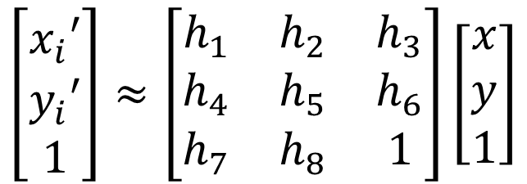
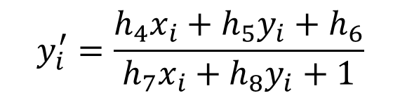
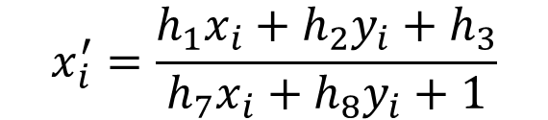
Direct Linear Transformation
$$\left[\begin{aligned}x_{i}′ \\ y_{i}′ \\ 1\end{aligned}\right]≈\left[\begin{matrix}h_{1} & h_{2} & h_{3} \\ h_{4} & h_{5} & h_{6} \\ h_{7} & h_{8} & 1\end{matrix}\right]\left[\begin{aligned}x \\ y \\ 1\end{aligned}\right]$$
$$x_{i}^{′}=\frac{h_{1}x_{i}+h_{2}y_{i}+h_{3}}{h_{7}x_{i}+h_{8}y_{i}+1}$$
$$y_{i}^{′}=\frac{h_{4}x_{i}+h_{5}y_{i}+h_{6}}{h_{7}x_{i}+h_{8}y_{i}+1}$$

Slide 14
Direct Linear Transformation
$$x_{i}^{′}\left(h_{7}x_{i}+h_{8}y_{i}+1\right)=h_{1}x_{i}+h_{2}y_{i}+h_{3}$$
$$y_{i}^{′}\left(h_{7}x_{i}+h_{8}y_{i}+1\right)=h_{4}x_{i}+h_{5}y_{i}+h_{6}$$
$$x_{i}^{′}\left(h_{7}x_{i}+h_{8}y_{i}+1\right)−h_{1}x_{i}+h_{2}y_{i}+h_{3}=0$$
$$y_{i}^{′}\left(h_{7}x_{i}+h_{8}y_{i}+1\right)−h_{4}x_{i}+h_{5}y_{i}+h_{6}=0$$

Slide 15
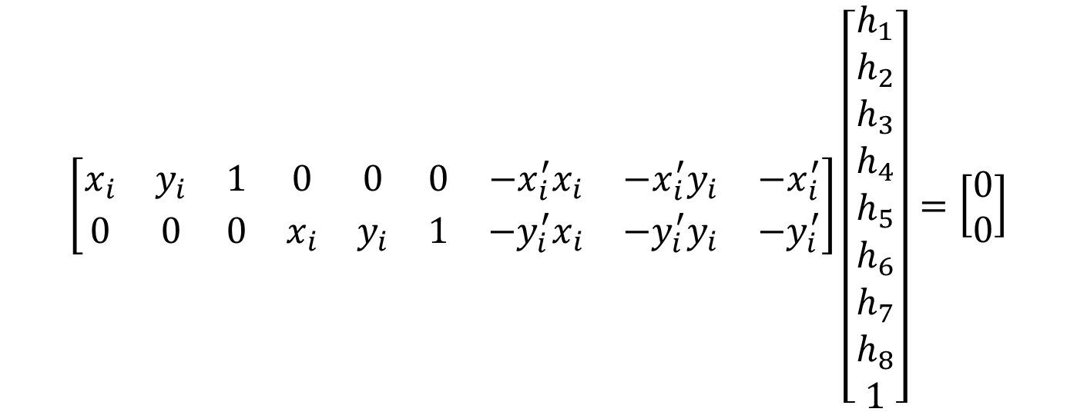
Direct Linear Transformation
$$\left[\begin{matrix}x_{i} & y_{i} & 1 & 0 & 0 & 0 & −x_{i}^{′}x_{i} & −x_{i}^{′}y_{i} & −x_{i}^{′} \\ 0 & 0 & 0 & x_{i} & y_{i} & 1 & −y_{i}^{′}x_{i} & −y_{i}^{′}y_{i} & −y_{i}^{′}\end{matrix}\right]\left[\begin{aligned}h_{1} \\ h_{2} \\ h_{3} \\ h_{4} \\ h_{5} \\ h_{6} \\ h_{7} \\ h_{8} \\ 1\end{aligned}\right]=\left[\begin{aligned}0 \\ 0\end{aligned}\right]$$

Slide 16
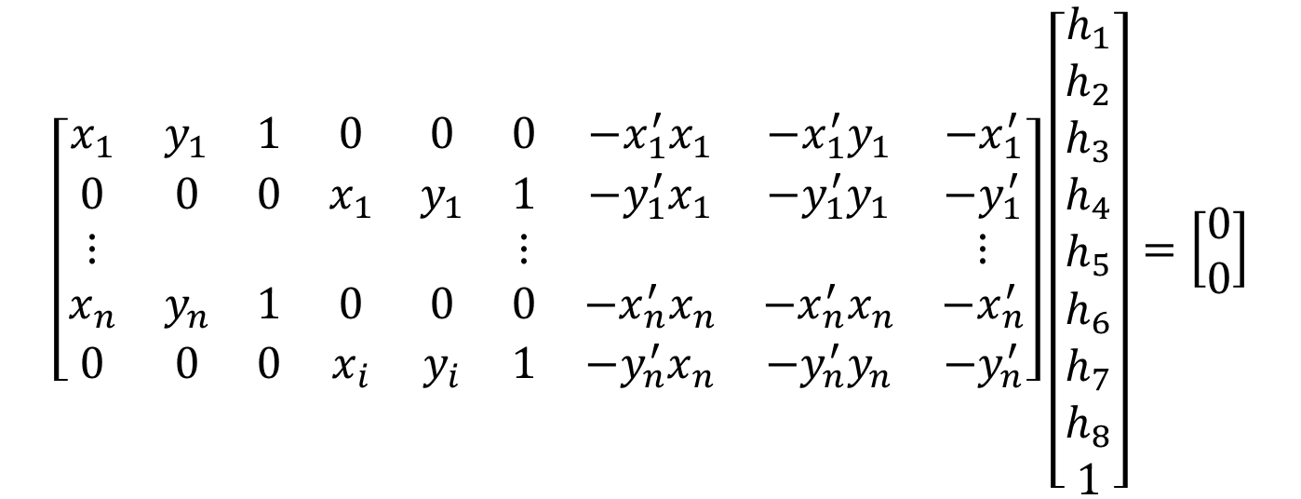


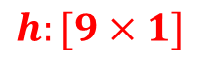
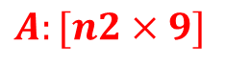
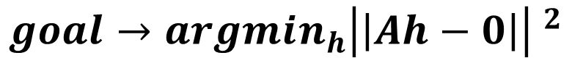
Direct Linear Transformation
$$h:[9×1]$$
$$\left[\begin{matrix}x_{1} & y_{1} & 1 & 0 & 0 & 0 & −x_{1}^{′}x_{1} & −x_{1}^{′}y_{1} & −x_{1}^{′} \\ 0 & 0 & 0 & x_{1} & y_{1} & 1 & −y_{1}^{′}x_{1} & −y_{1}^{′}y_{1} & −y_{1}^{′} \\ ⋮ & & & & & ⋮ & & & ⋮ \\ x_{n} & y_{n} & 1 & 0 & 0 & 0 & −x_{n}^{′}x_{n} & −x_{n}^{′}x_{n} & −x_{n}^{′} \\ 0 & 0 & 0 & x_{i} & y_{i} & 1 & −y_{n}^{′}x_{n} & −y_{n}^{′}y_{n} & −y_{n}^{′}\end{matrix}\right]\left[\begin{aligned}h_{1} \\ h_{2} \\ h_{3} \\ h_{4} \\ h_{5} \\ h_{6} \\ h_{7} \\ h_{8} \\ 1\end{aligned}\right]=\left[\begin{aligned}0 \\ 0\end{aligned}\right]$$
$$A:[n2×9]$$
$$0:[n×1]$$
For $n$ matches
$$goal→argmin_{h}{\left|\left|Ah−0\right|\right| }^{2}$$

Slide 17
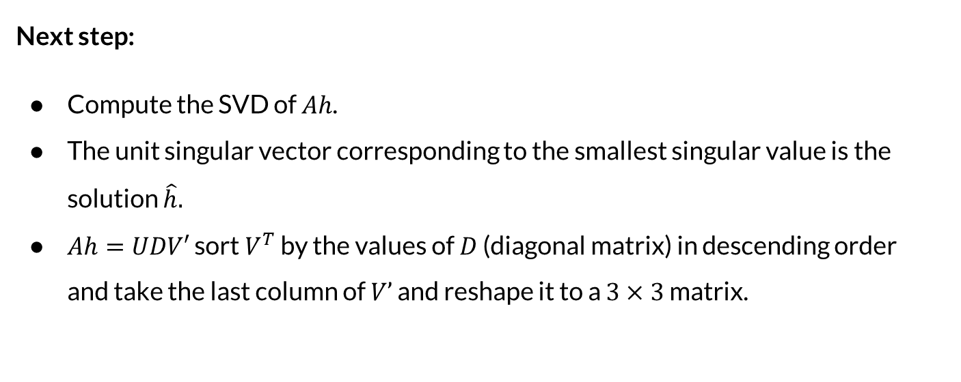
Direct Linear Transformation
Next step:
Compute the SVD of $Ah$.
The unit singular vector corresponding to the smallest singular value is the solution $\hat{h}.$
$Ah=UDV′$ sort $V^{T}$ by the values of $D$ (diagonal matrix) in descending order and take the last column of $V’$ and reshape it to a $3×3$ matrix.

Slide 18
RANSAC

Slide 19


Finding matching points

Slide 20

Find transformation

Slide 21
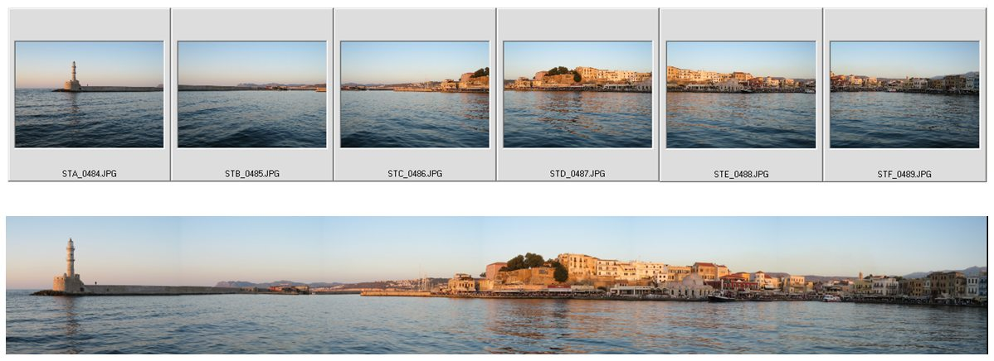
But how to find matches?
?
They all look like a good match...

Slide 22
But how to find matches?
How about finding a consensus?

Slide 23
But how to find matches?
For this matching, not all points have the same transformation.

Slide 24
But how to find matches?
Now that’s a match!

Slide 25
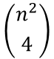
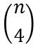
But how to find a consensus?
For n points, there could be transformations!
we need 4 matches for a projection transformation
Let’s match the key points by matching each keypoint on the right to its best match on the left. Now we only have transformations to check, still a lot.
And how do we know if it’s a good matching?
$$\left({n^{2} \atop 4}\right)$$
$$\left({n \atop 4}\right)$$

Slide 26
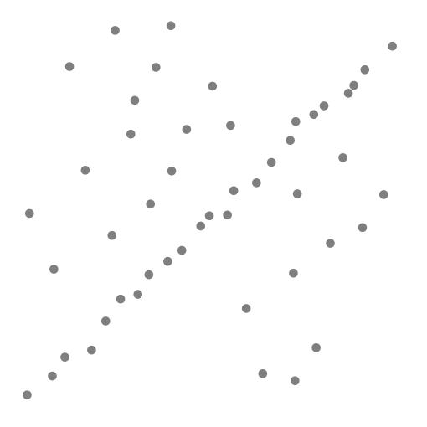
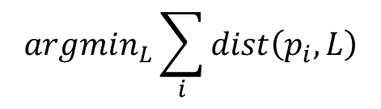
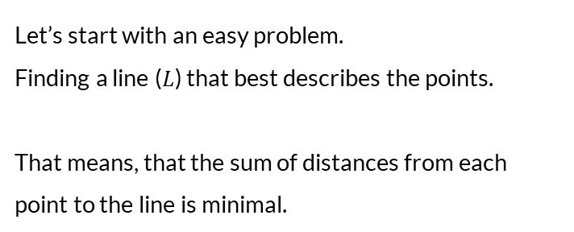
RAndom SAmple Consensus (RANSAC)
Let’s start with an easy problem.
Finding a line ($L$) that best describes the points.
That means, that the sum of distances from each point to the line is minimal.
$$argmin_{L}\sum_{i}{dist\left(p_{i},L\right)}$$

Slide 27
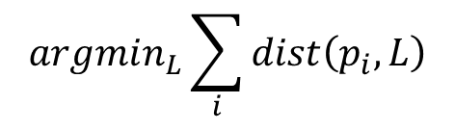
RAndom SAmple Consensus (RANSAC)
If we used Least Squares, the outcome will be affected by outliers.
$$argmin_{L}\sum_{i}{dist\left(p_{i},L\right)}$$

Slide 28
Random sample consensus
RanSAC algorithm: bestLine = None
max_inlrs= -inf
For i in k:
p1,p2 = choose2points()
tmpL = findLine(p1,p2)
tmp_inlrs = # inliers
if tmp_inlrs > max_inlrs:
max_inlrs= tmp_inlrs
bestLine = tmpL
return bestLine

Slide 29
Random sample consensus
RanSAC algorithm:
bestLine = None
max_inlrs= -inf
For i in k:
p1,p2 = choose2points()
tmpL = findLine(p1,p2)
tmp_inlrs = # inliers
if tmp_inlrs > max_inlrs:
max_inlrs= tmp_inlrs
bestLine = tmpL
allPointsOnLine = [p in P if dist(p,bestLine)<thrs]
bestLine = findLine(allPointsOnLine) # Least Squares
return bestLine

Slide 30
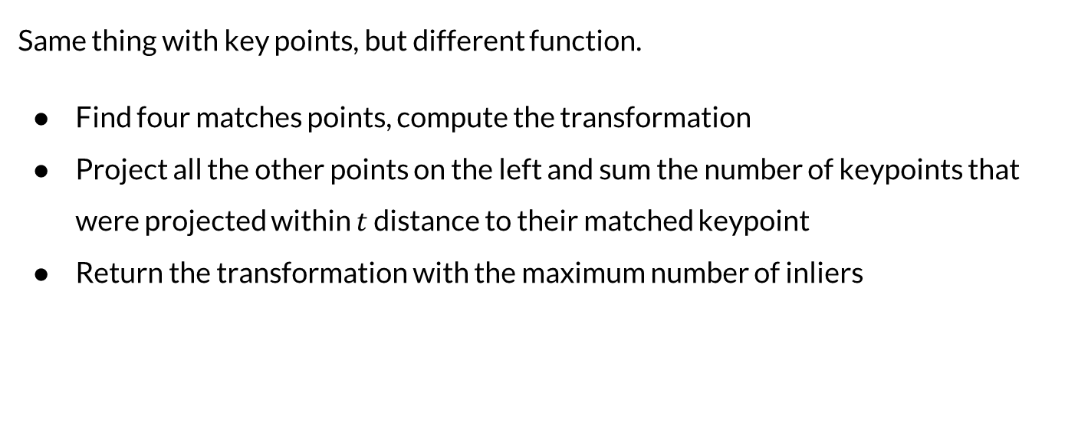
Random sample consensus
Same thing with key points, but different function.
Find four matches points, compute the transformation
Project all the other points on the left and sum the number of keypoints that were projected within $t$ distance to their matched keypoint
Return the transformation with the maximum number of inliers

Slide 31
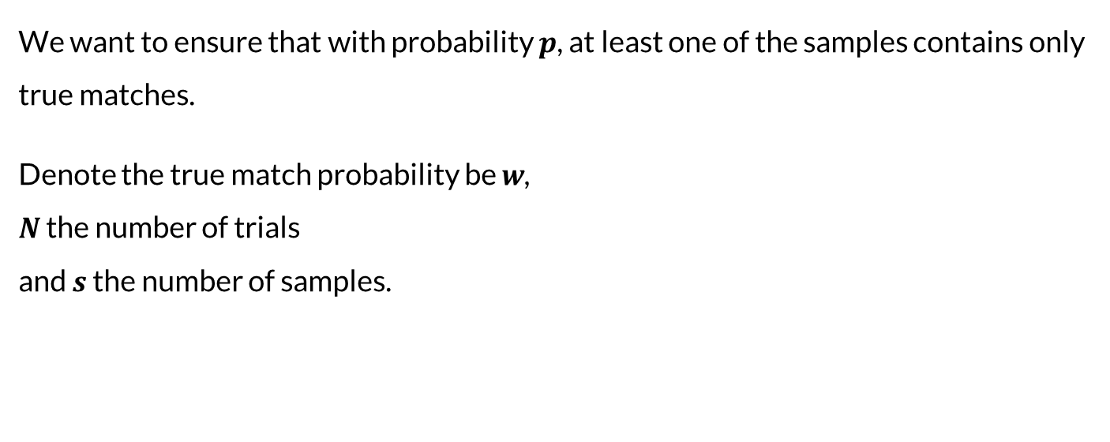
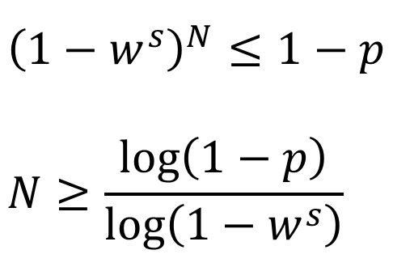
How many random trials?
We want to ensure that with probability $p$, at least one of the samples contains only true matches.
Denote the true match probability be $w$, $N$ the number of trials and $s$ the number of samples.
$${\left(1−w^{s}\right)}^{N}≤1−p \\ N≥\frac{\log\left(1−p\right)}{\log\left(1−w^{s}\right)}$$

